Slide 1
Arithmetic progressions
Let us generate a sequence as follows :
3,7,11,15,19,23………………..
3, 3+4, 3+8, 3+12, 3+16, 3+20,
3, 3+1(4), 3+2(4), 3+3(4), 3+4(4),
a, (a+d), (a+2d), (a+3d), (a+4d),…………(a+ (n-1)d)
The first term is ‘a’
The common difference = ‘d’
The last term = a+(n-1)d

Slide 2

7.Arithmetic Progressions
An arithmetic progression ( A.P) is a sequence of numbers in which any number , other than the first number, is more or less than the immediate next value by a constant.
This constant difference is called the common difference denoted by ‘d’
The general sequence is
a, (a+d), (a+2d), (a+3d), ………………….. (a+ (n-1)d)
‘a ‘is the first term a+(n-1)d is the last term
Sum of ‘n’ terms = n/2 [2a + (n-1)d]
Also sum = n/2[ 1st term + last term]
Arithmetic Mean of an A. P = ½ [2a + (n-1)d]

Slide 3

A.P
Find the first term and common difference of an A.P if the 4th term is 28 and 11th term is 84.
$t_{11}$ = a+10d = 84
$t_{4 }$ = a = 3d = 28
--→ 7d = 56
d = 8
a + 3(8) = 28 => a= 4

Slide 4
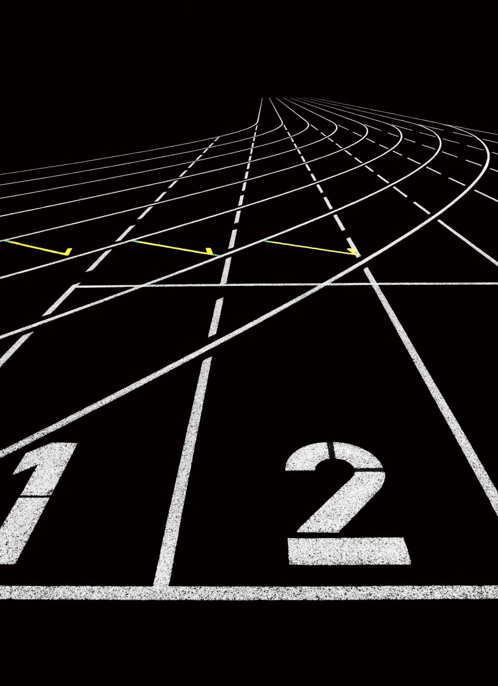

exercise
Find the number of terms if the twelfth term is 37 and the sixth term is 19 , given the nth term is 67.
$t_{12 }$ = a + 11d = 37
$t_{6}$ = a + 5d = 19
-> 6d = 18 or d= 3
a + 5 x 3 = 19 → a = 4
$t_{n }$ = a + (n-1)d = 67
= 4 + (n-1) 3 = 67
n = 22

Slide 5

A.P
There are 3 numbers in A.P whose sum is 30 and the product 960. Find the numbers.
Let the three numbers be (a-d), a and (a+d)
Their sum = 3a = 30 -→ a = 10
Their product = a($a^{2}$ – $d^{2}$ ) = 10 ( 100 - $d^{2}$) = 960
=> 100 - $d^{2}$ = 96 or $d^{2}$ = 4, d = $±$ 2
The numbers in an ascending order are 8, 10, 12

Slide 6


A.P
The sum of three numbers in A.P is 33 and the sum of their squares is 395. Find the numbers.
Let the three numbers be (a-d), a and (a+d)
sum = 3a = 33 -→ a = 11
${(a−d)}^{2}$ + $a^{2}$+ ${(a+d)}^{2}$ = 395
3 $a^{2}$ + 2 $d^{2}$ = 395
3 x 121 + 2 $d^{2}$ = 395
2 $d^{2}$ = 395 – 363 = 32 → $d^{2}$ = 16, d = 4
The numbers are 7,11,15
$${}^{2}$$

Slide 7
A.P
Find the arithmetic mean of an A.P with 51 terms whose 1st term is 3.5 and the common difference is 0.6 .
Arithmetic mean of an A.P = ½ [ 2a + (n-1)d ]
Arithmetic mean = ½ [ 2 x 7/2 +(51-1) 3/5]
= ½ [ 7 + 30 ] = 37/2 = 18.5

Slide 8


A.P
What is the sum of all three digit numbers which leaves a remainder of 3 , when divided by 7?
The first three digit number is 101 and the last is 997
a = 101 d = 7 and last term = 997
$t_{n}$ = a + (n-1) d = 997
101 + (n-1) 7 = 997
n = 129
Sum = 129/2 [101 + 997] = 129/2 x 1098 = 129 x 549
= 70821

Slide 9

A.P
What is the sum of all positive integers up to 1000, which are divisible by 5 and are not divisible by 2?
1) 10,050 2) 5050 3) 5000 4)) 30,000 5) 50,000
Not divisible by 2 , means odd multiples of 5 only.
5, 15, 25 ,………………………………….., 995
a = 5 , d = 10 and = 995
995 = 5 + (n-1) 10
n = 100
Sum = 100/2 [5 + 995 ] = 50,000
$t_{n}$

Slide 10
A.P
What is the sum of the following series? -64, -66, -68, ..... , -100
-1458
-1558
-1568
-1664
None of the above

Slide 11
A.P
An Arithmetic Progression has 23 terms, the sum of the middle three terms of this arithmetic progression is 720, and the sum of the last three terms of this Arithmetic Progression is 1320. What is the 18th term of this Arithmetic Progression?
A. 240 B. 360 C. 340 D. 440 E. 560
Sum of the middle three terms = 11th + 12th +13th terms
a+ 10d + a + 11d + a + 12d = 720 → 3a + 33d + 720
a + 11d + 240 ------------→ 1
Sum of the last three terms = 21st + 22nd + 23rd terms
a + 20d + a + 21d + a + 22d = 1320 -→ 3a + 63d = 1320
a + 21d = 440 --------------→ 2 ➔ d = 20 and a = 20

Slide 12
A.P
The sum of the first six terms of an AP is 48 and the common difference is 2. What is the 4th term?
A. 6 B. 7 C. 9 D. 10 E.12
= 48
3[2a+ 5d] = 48 -→ 2a + 5d = 16
2a + 10 = 16 -→ a = 3
4th term = a + 3d = 3 + 6 = 9

Slide 13
A.P
The first term of an AP is 3 and the last term is 17. If the sum of all terms is 150, what is the 5th term?
A. 5 B. 7 C. 9 D. 11 E. 13
The sum of all terms is =n/2 ​(1st term + last term) =150.
n/2×20=150
n=15
a15​=17
a+14d=17
d=1
Therefore, 5th term is a+4d=7.

Slide 14
A.P
Sum of first 25 terms in AP is 525, sum of the next 25 terms is 725, what is the common difference?
Let a and d be the first term and common difference of AP respectively.
Sum of the first 25 terms in AP is 525
S₂₅ = (25/2)[(2a+(25–1)d)]
525 = 25a+(25)12d
21=a+12d ——(1)
Sum of the next 25 terms is 725
Sum of next 25 terms (S₂₅’ )= Sum of 50 terms-Sum of first 25 terms
S₅₀= (50/2)[2a+(49d)]
S₅₀= 50a+1225d
S₂₅’ = S₅₀-S₂₅ = 50a+1225d-525
725 = 50a+1225d-25a-300d
725 = 25a+925d
29= a+37d—-(2)
Solving for a and d from (1) and (2), d = 8/25

Slide 15
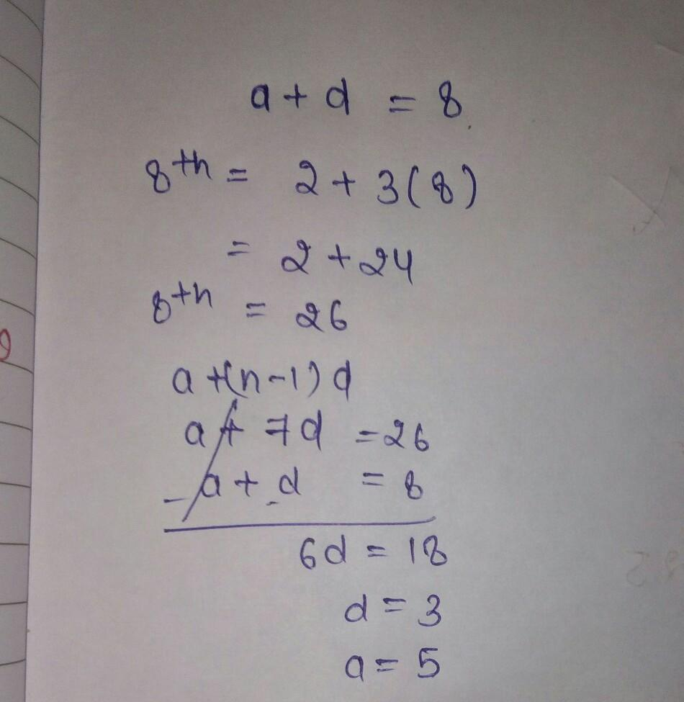
A.P
Second term in an AP is 8 and the 8th term is 2 more than thrice the second term. Find the sum up to 8 terms of this AP.
A.124 B. 108 C. 96 D. 110 E. 115

Slide 16
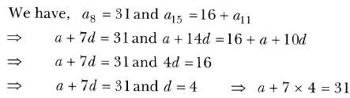
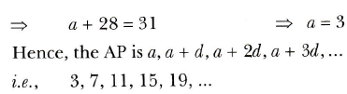
A.P
If the 8th term of an A. P. is 31 and the 15th term is 16 more than the 11th term, find the A. P.

Slide 17
A.P
The sum of 4th and 8th terms of an A. P. is 24 and the sum of 6th and 10th terms is 34. Find the first term and the common difference of the A. P.
a4+a8=24 a+3d+a+7d=24 2a+10d=24. .........1 a6+a10=34 a+5d+a+9d=34 2a+14d=34. .,.......2 Subtracting 2 from 1 2a+14d=34 2a+10d=24 4d=10
d = 5/2
a + 5d = 12
a = - 0.5

Slide 18
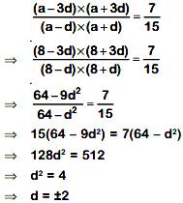
A.P
The sum of four consecutive numbers in an AP is 32 and the ratio of the product of the first and the last terms to the product of the two middle terms is 7 : 15. Find the numbers.
Let the four consecutive numbers in A.P. are (a – 3d), (a – d), (a + d) and (a + 3d). According to the condition given, (a – 3d) + (a – d) + (a + d) + (a + 3d) = 32 4a = 32
a = 8 ...(i)
and, according to the 2nd condition given,
Numbers are 2, 6, 10 and 14 or 14, 10, 6 and 2.

Slide 19
A.P
The sum of the first n terms of an A.P whose first term is 8 and the common difference is 20 is equal to the sum of first 2n terms of another AP whose first term is - 30 and the common difference is 8. Find n.
Sn=n/2(2a + (n-1)d) Given, a=8 and d=20 Sn=n/2(2(8) + (n-1)20) Sn=n/2(16 + 20n -20) Sn=n/2(20n - 4) Sn=n(10n-2) -------(1) When a=-30 and d=8 S2n=2n/2(2(-30) + (2n-1)8) S2n=n(-60 +16n -8) S2n=n(-68 + 16n)--------(2) It is given that Sn=S2n n(10n-2)=n(-68 + 16n) 10n-2=-68 + 16n 6n=66 n=11

Slide 20
A.P
If the sum of 7 terms of an A. P. is 49 and that of 17 terms is 289, find the sum of n terms.

Slide 21
A.P
Three positive numbers are in A .P . If the third number is multiplied by 4/3, Then the numbers would be in G.P . Find the common ratio.
Let the three numbers be (a-d), a and (a+d)

Slide 22
A.P
In an A.P a_{p} = q an a_{q} = p then a_{n} = ?
Let first term be a and common difference be d.
pth term = a + (p-1)d = q -----(i)
qth term = a + (q-1)d = p -----(ii)
(ii) - (i) gives
(q - p)d = p - q or d = -1
(i) gives a = q - (p-1)d = q - (p-1)(-1) = q + p - 1
Hence,
nth term = a + (n-1)d = q + p -1 + (n-1)(-1) = q + p -1 + n +1 =
p + q - n

Slide 23




A.P
In an A.P 31st term is 40, then the sum of 61 terms of that A.P

Slide 24
Geometric Progression
A sequence of numbers in which the ratio of any number , other than the first, to the preceding one is the same.
The general G.P is {a, ar, ar², ar³, ... }
where: a is the first term, and
r is the factor between the terms (called the "common ratio")
The nth term = t_{n} = ar^{(n-1)}
S_{n} = a (r^{n} -1)/ (r-1) , r >1
S_{∞ = a/(1 – r) , r < 1}

Slide 25
G.P
Find three numbers in G.P having the sum of 21 and product 216.

Slide 26
G.P
The number 2048 is which term in the following Geometric sequence 2, 8, 32, 128, . . . . . . . . .

Slide 27
G.P
Given A = 2⁶⁵ and B = (2⁶⁴+2⁶³+2⁶²+...+2⁰), which of the following is true?
B is 2⁶⁴ larger than A
A and B are equal
B is larger than A by 1
A is larger than B by 1

Slide 28
G.P
If the sum of the first five terms of a G.P is 1364 and the common ratio is ¼ find the first term

Slide 29
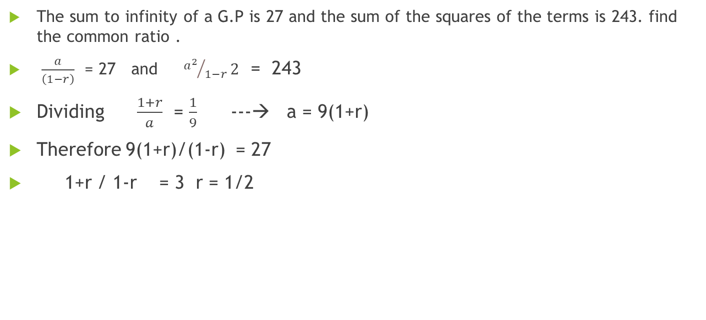
G.P
The sum to infinity of a G.P is 27 and the sum of the squares of the terms is 243. find the common ratio .
$\frac{a}{\left(1−r\right)}$ = 27 and ${a^{2}}/{1−r}2$ = 243
Dividing $\frac{1+r}{a}$ = $\frac{1}{9}$ ---→ a = 9(1+r)
Therefore 9(1+r)/(1-r) = 27
1+r / 1-r = 3 r = 1/2

Slide 30
G.P
The product of three numbers in G.P is 216 and the sum of the product of the numbers taken two at a time is 156. find the least number .
let a/r , a , ar are in GP A/C to question, (a/r ) × a × ar = 216 a³ = 216 a³ = (6)³ a = 6
again, sum of their products in pair = 156 (a/r ) × a + a × ar + ar × (a/r) = 156 a²/r + a²r + a² = 156 36/r + 36r + 36 = 156 36( 1/r + r + 1) = 156 3(r² + r + 1) = 13r 3r² + 3r + 3 - 13r = 0 3r² -10r + 3 = 0 3r² - 9r - r + 3 = 0 r = 3 and 1/3 The three numbers are 2. 6 and 18 . Therefore the least number is 2

Slide 31
G.P
The arithmetic mean of two numbers is 17 and their geometric mean is 15. Find the bigger of the two numbers.

Slide 32
G.P
The first two terms of a geometric progression add up to 12. The sum of the third and the fourth terms is 48. If the terms of the geometric progression are alternately positive and negative, then the first term is
A) –4 B) –12 C) 12 D) 4 E) -10
Ratio is negative
Let G.P., a, ar, ar2, ar3 Given a+ar=12... (i)
and ar2+ar3=48=r2(a+ar)=48.
⇒r2(12)=48 using(i)
⇒r2=4=r=±2

Slide 33
G.P
Sum of first 12 terms of a GP is equal to the sum of the first 14 terms in the same GP. Sum of the first 17 terms is 92, what is the third term in the GP?
92 B) -92 C) 46 D) -231 E) -46

Slide 34
Solution
Sum of first 12 terms is equal to sum of first 14 terms. Sum of first 14 terms = Sum of first 12 terms + 13th term + 14th term => 13th term + 14th term = 0 Let us assume 13th term = k, common ratio = r. 14th term will be kr. k + kr = 0 k (1 + r) = 0 => r = -1 as k cannot be zero Common ratio = -1. Now, if the first term of this GP is a, second term would be -a, third would be a and so on The GP would be a, -a, a, -a, a, -a,... Sum to even number of terms = 0 Sum to odd number of terms = a Sum to 17 terms is 92 => a = 92 Third term = a = 92
Hence the answer is "92"

Slide 35
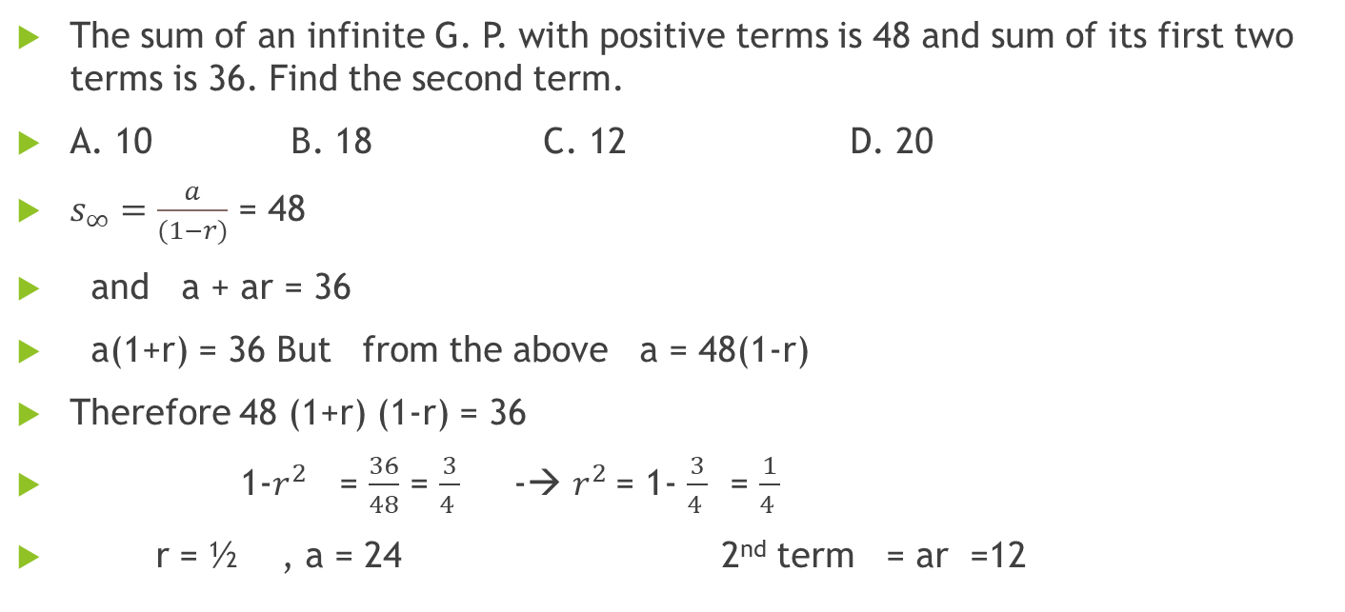
G.P
The sum of an infinite G. P. with positive terms is 48 and sum of its first two terms is 36. Find the second term.
A. 10 B. 18 C. 12 D. 20
$s_{∞}=\frac{a}{(1−r)}$ = 48
and a + ar = 36
a(1+r) = 36 But from the above a = 48(1-r)
Therefore 48 (1+r) (1-r) = 36
1-$r^{2}$= $\frac{36}{48}$ = $\frac{3}{4 }$ -→ $r^{2}$= 1- $\frac{3}{4 }$ = $\frac{1}{4 }$
r = ½ , a = 24 2nd term = ar =12

Slide 36
A.P & G.P
The arithmetic mean between two numbers is 75 and their geometric mean is 21. Find the numbers.
A. 133 and 17
B. 63 and 87
C. 3 and 147
D. 73 and 77

Slide 37

G.P
Find the common ratio of a G.P whose first term is 16 and the last term is
1/256 and the sum of the terms of the G.P is 5461/256.
$t_{n}= {ar}^{(n−1)}$ = 1/256
$s_{n}$ = $a\frac{\left(1−r^{n}\right)}{\left(1−r\right)}$ = $\frac{a−a r{ .r}^{(n−1)}}{(1−r)}$ = [16 – r (1/256)]/ (1-r) = 5461/256
= $\frac{4096 −r}{256 ( 1−r)}$ = $\frac{5461}{256}$ -----→ 4096 – r = 5461 – 5461r
5460 r = 1365
r = $\frac{1365}{5460}$ = ¼

Slide 38
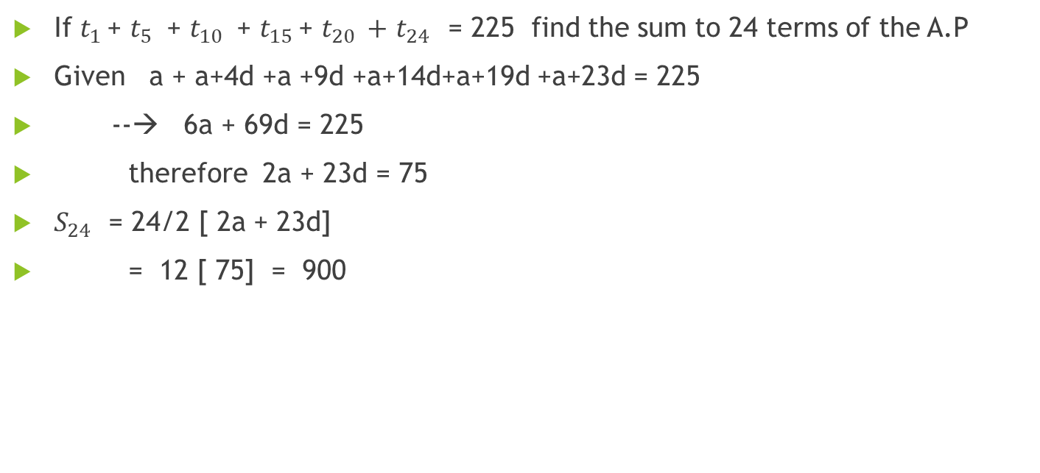
If $t_{1 }$+ $t_{5 }$ + $t_{10 }$ + $t_{15 }$+ $t_{20 }+$ $t_{24 }$ = 225 find the sum to 24 terms of the A.P
Given a + a+4d +a +9d +a+14d+a+19d +a+23d = 225
--→ 6a + 69d = 225
therefore 2a + 23d = 75
$S_{24 }$ = 24/2 [ 2a + 23d]
= 12 [ 75] = 900

